Slide 1



European Project Semester
Christopher Mahon
Melanie Tscholl
Manuel Baptista
Marta Majewska
Sven Bergervoet

Slide 2


INDEX
Introduction Setsun
Project management
Marketing
Eco-efficiency Measures for Sustainability
Ethical and Deontological Concerns
Construction
Electronics
Conclusion
Video

Slide 3
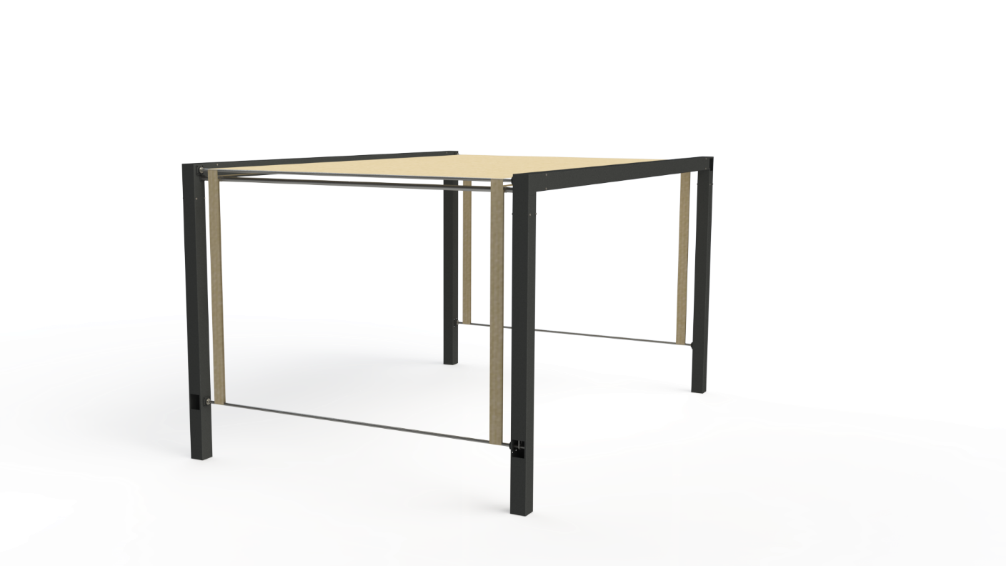
Introduction Setsun

Slide 4

Project Management

Slide 5

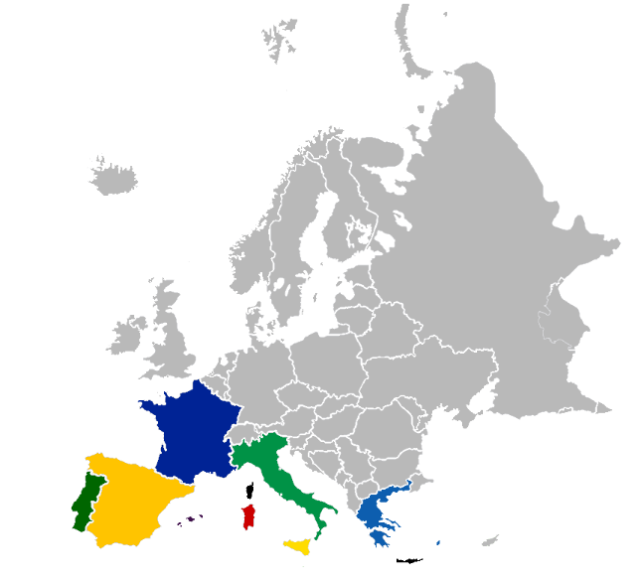
Marketing

Slide 6

Ethical and Deontological Concerns

Slide 7


Eco-efficiency Measures for Sustainability
Low material carbon intensity (CO2/kg)
Materials with an high recycle fraction (%)

Slide 8
Construction

Slide 9
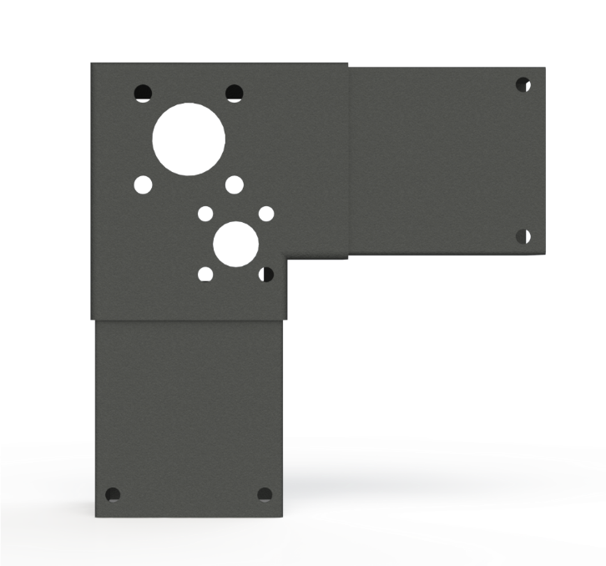

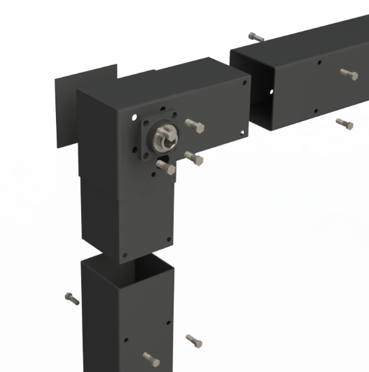
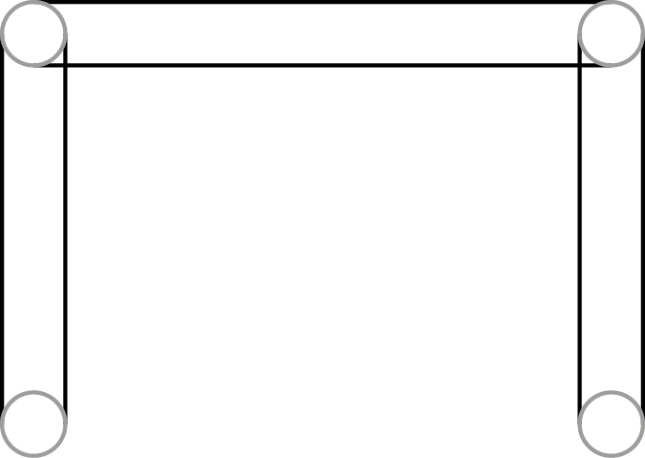
Construction Bow
3
1
4
2

Slide 10
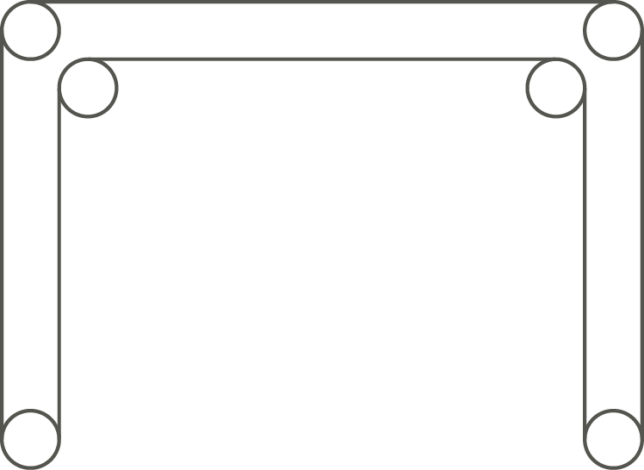
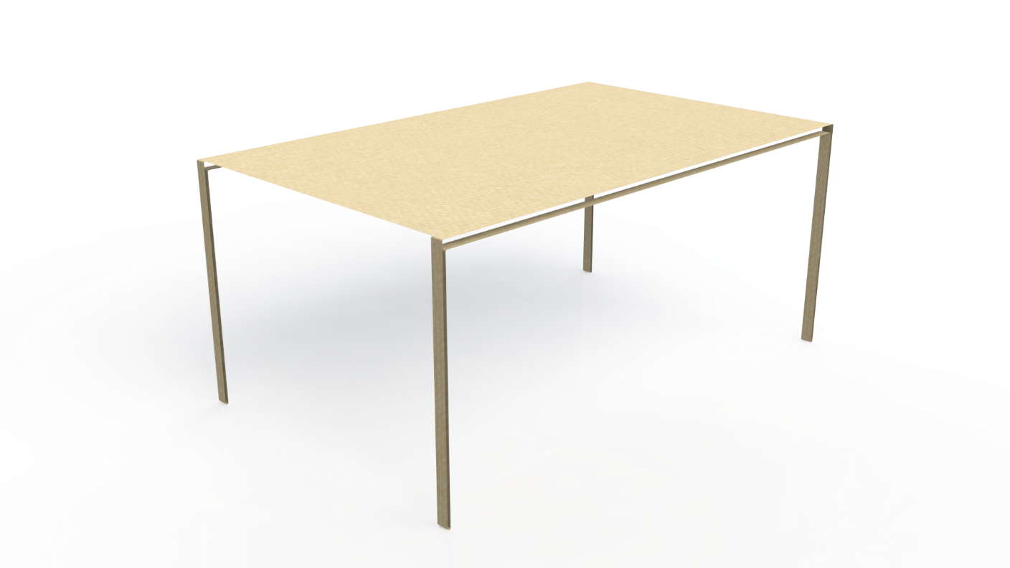
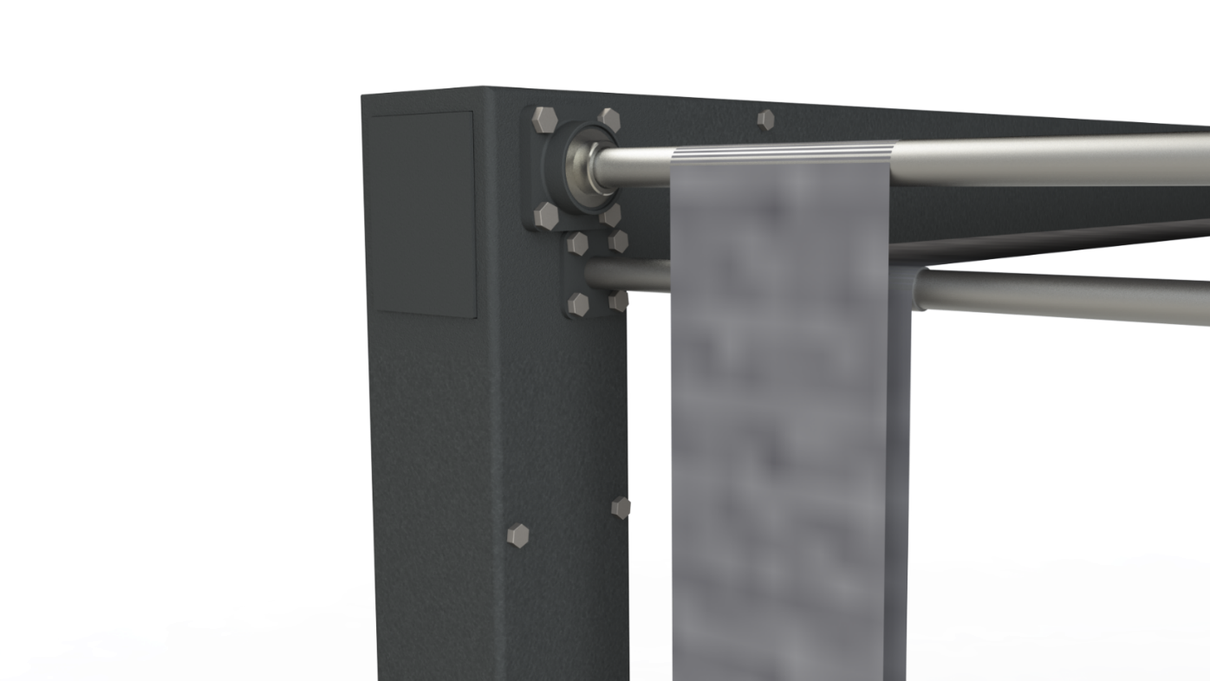
Mesh
2
1
3

Slide 11
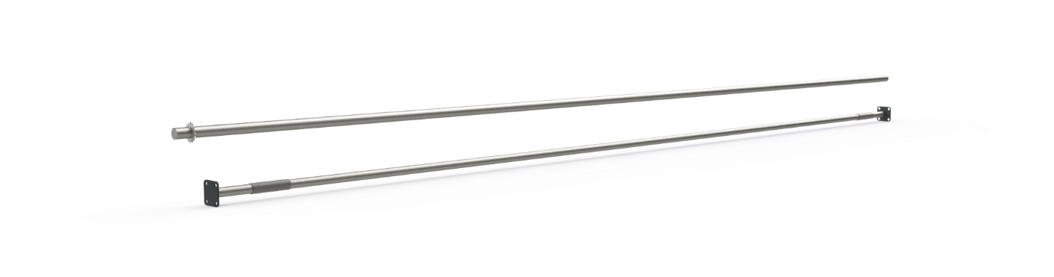
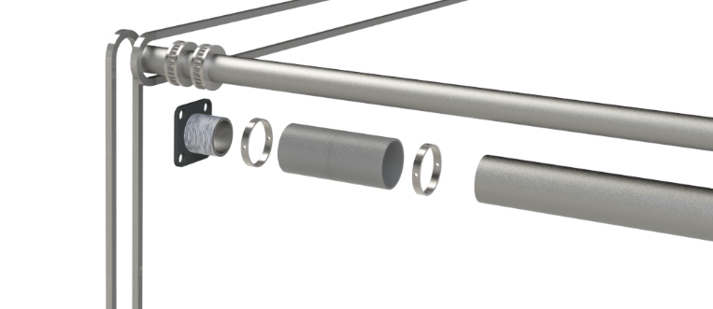
Horizontal Bars
1
2
3

Slide 12
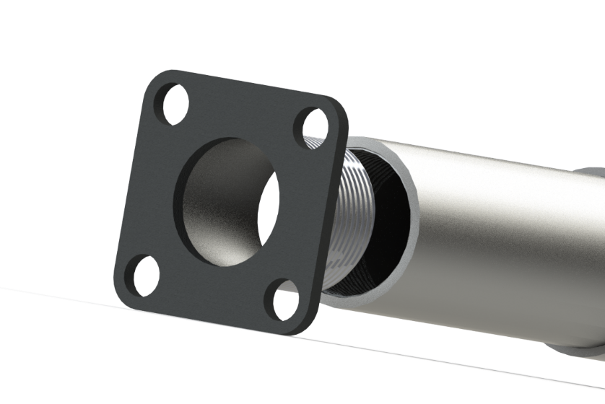
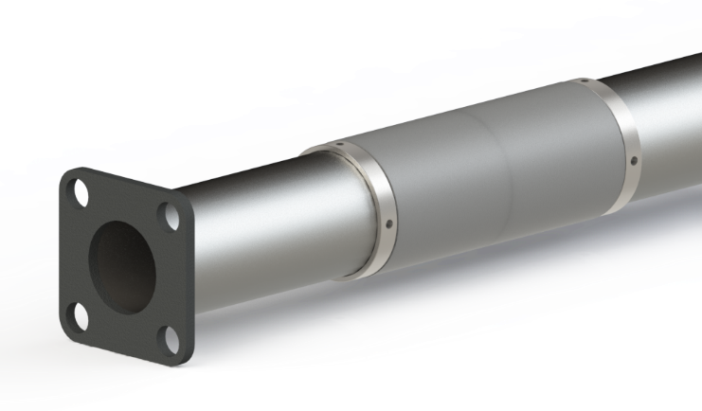
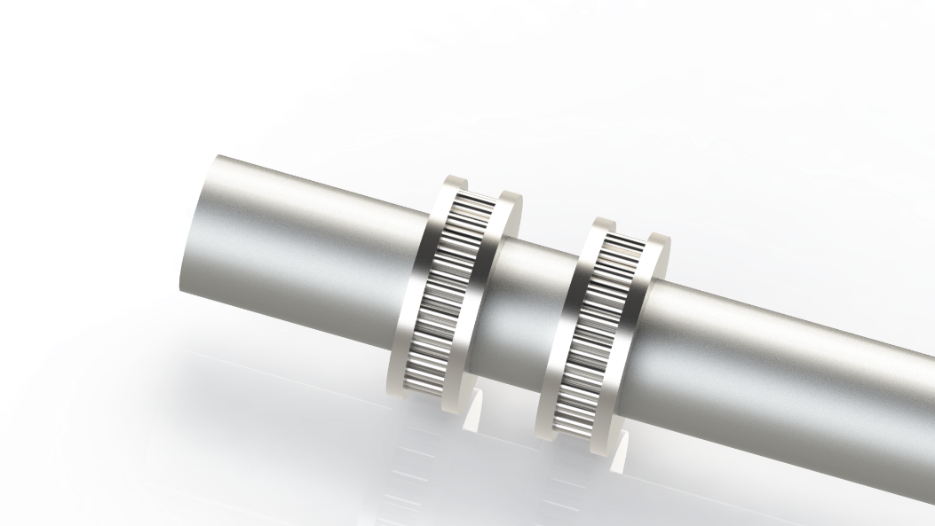
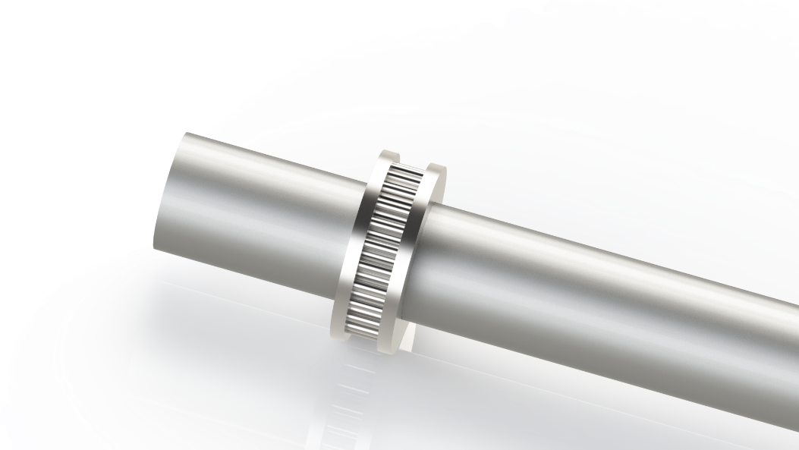
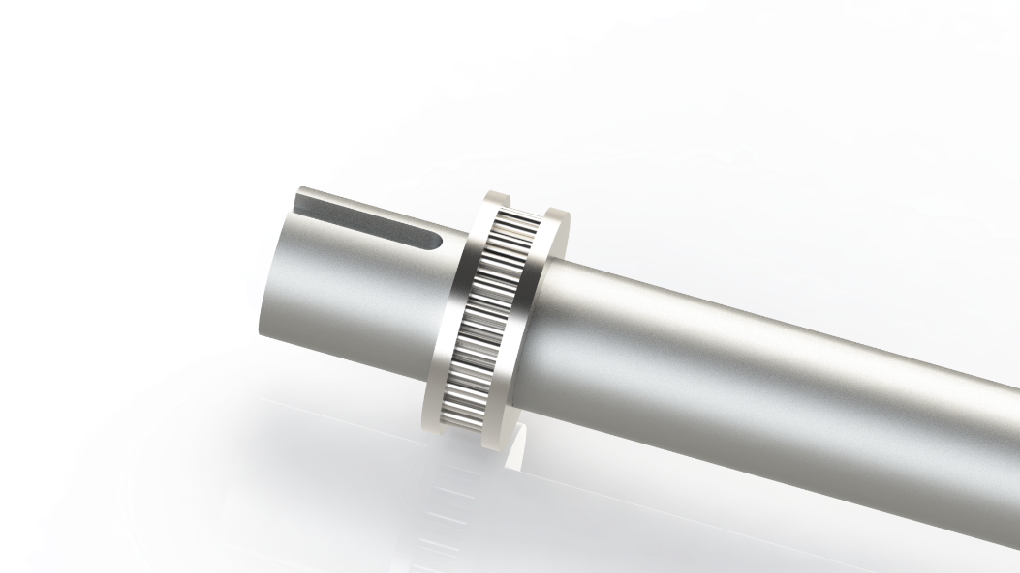
Horizontal Bars
1
2
3
4
5

Slide 13
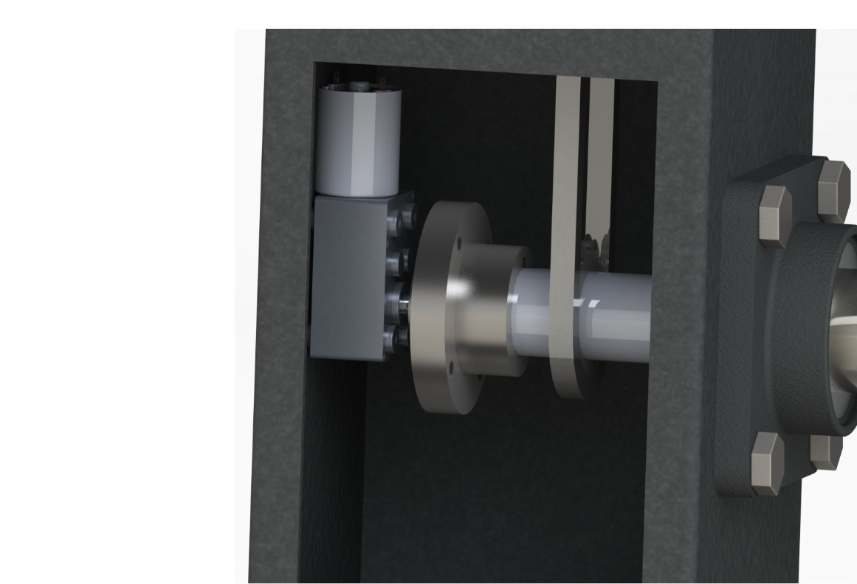
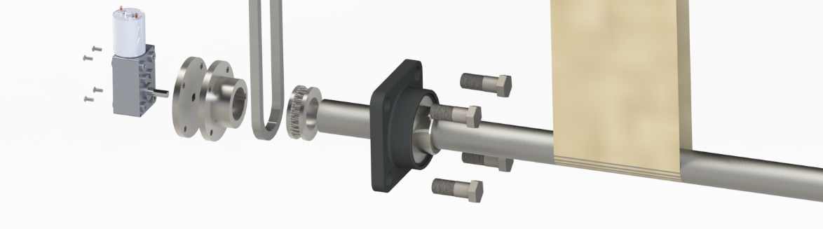
Motor
1
2

Slide 14
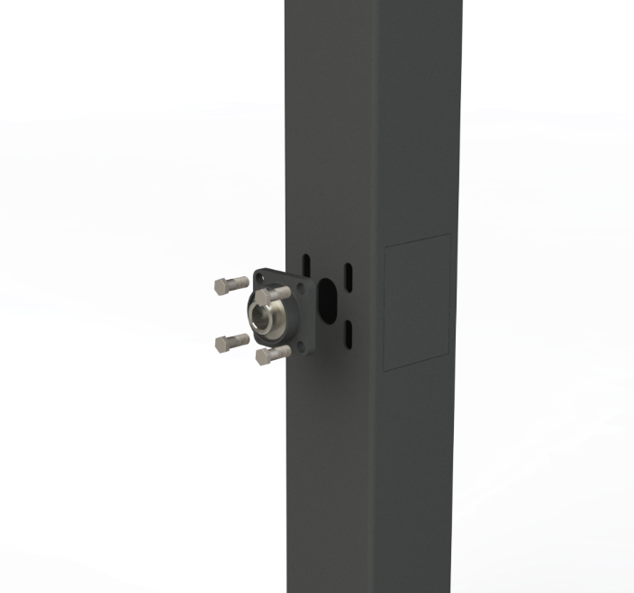


Additional features
1
2
3

Slide 15
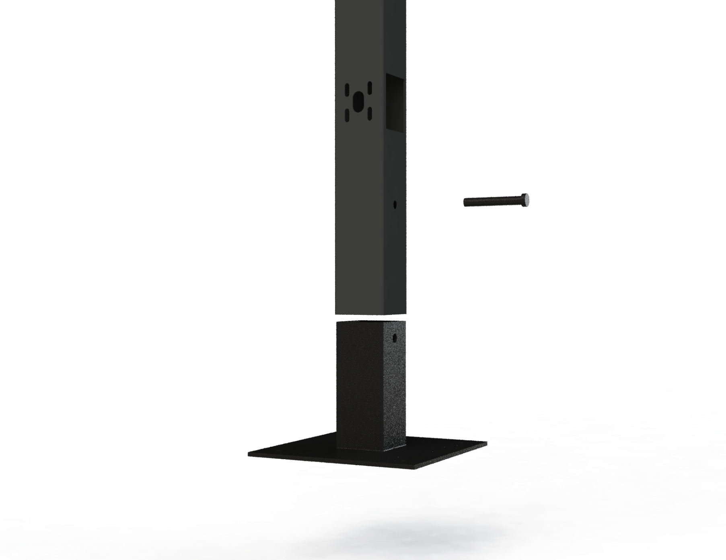
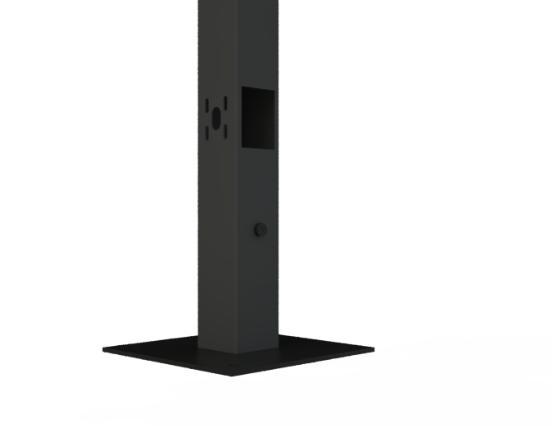
Footpiece

Slide 16
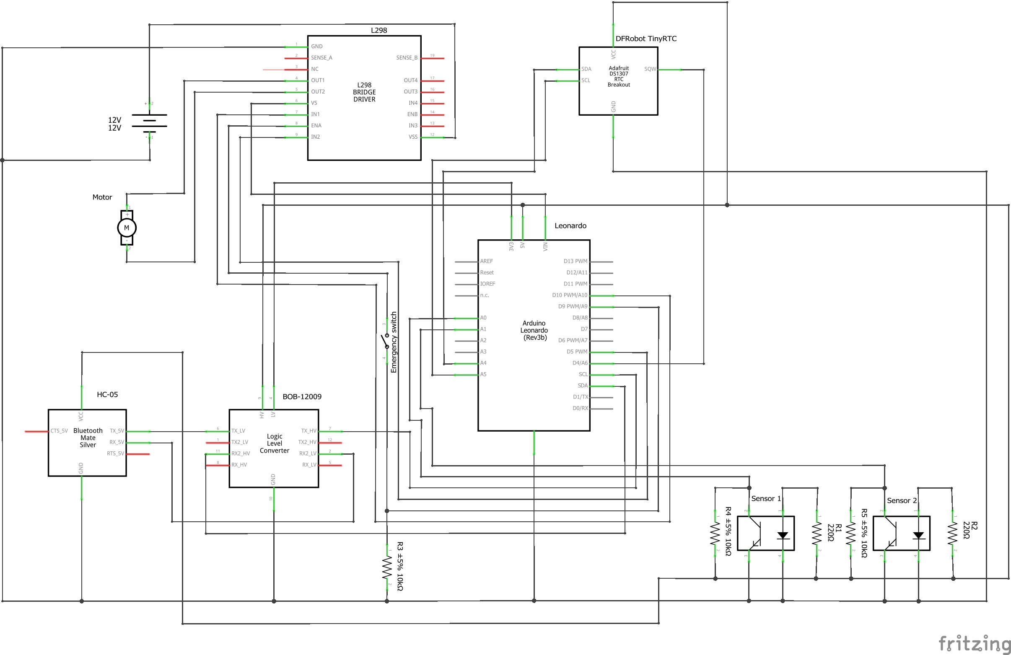
Electronics

Slide 17

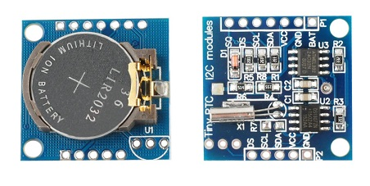

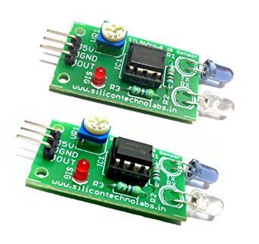
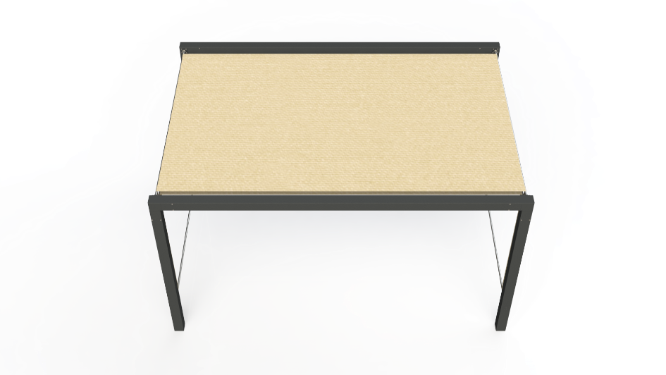
Electronics
SPA

Slide 18
Conclusion
Improved the skills on our own expertise with constructing a new product
Improved teamwork skills
Being able to work with people from other cultural backgrounds

Slide 19

Video

Slide 20
THANKYOU

