Slide 1
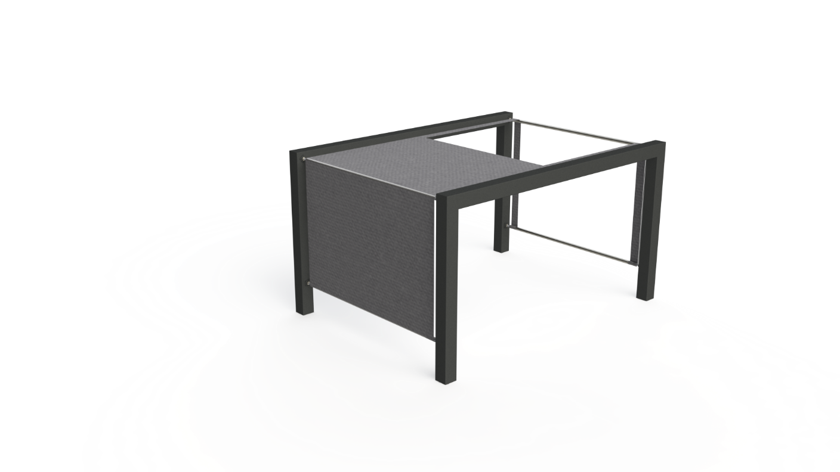

Team 4:
Christopher Mahon - Electric, Electronic and Energy Engineering
Manuel Baptista - Mechanical Engineering
Marta majewskac - Logistics
Melanie Tscholl - Media Technologies
Sven Bergervoet - Industrial Product Design

Slide 2
index
Introduction
State of the art
Project management
Eco-efficiency Measures for Sustainability
Ethical and Deontological Concerns
Product development

Slide 3
introduction

Slide 4
problem
How can a shader be constructed so that there is a constant shade on the terrace while using smart electronics?
What is the design?
How can it be constructed?
How do the electronics work?
How is this product going to be presented to the target audience?

Slide 5
requirements

Slide 6
State of Art

Slide 7
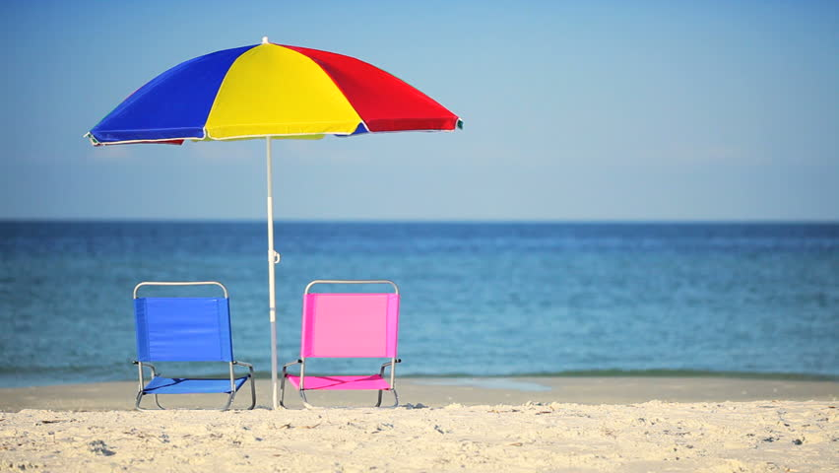
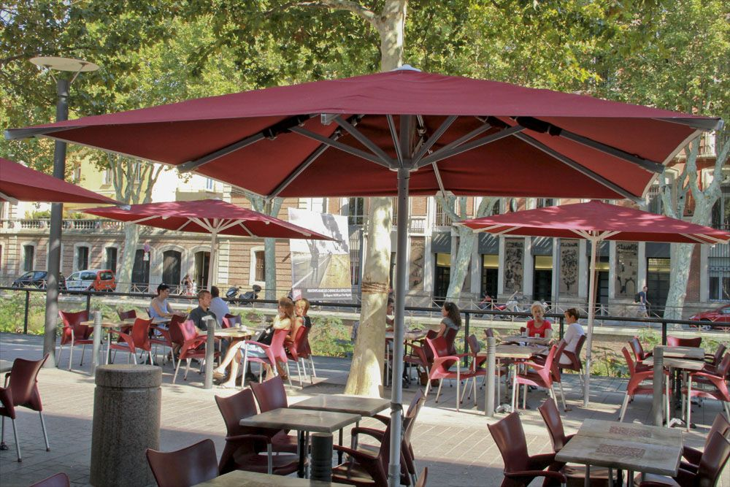
parasol

Slide 8
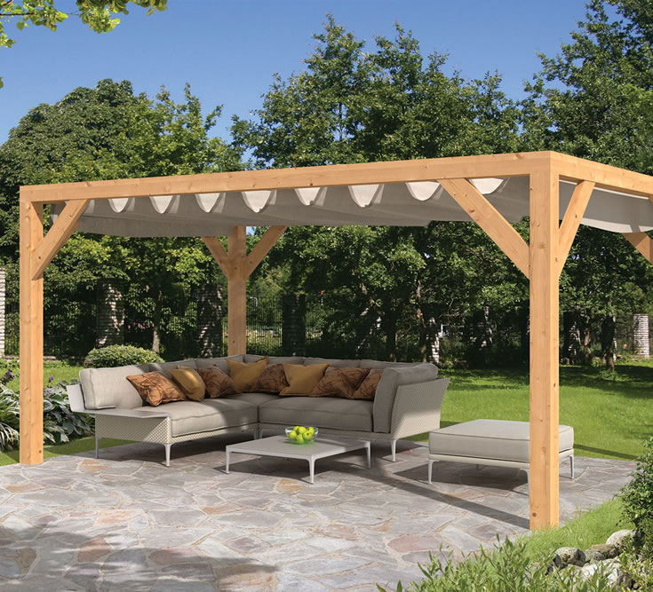
canopy

Slide 9
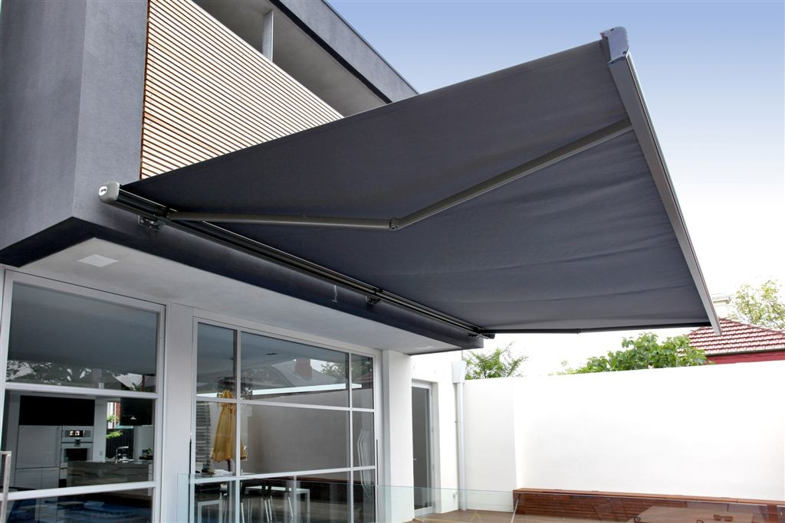
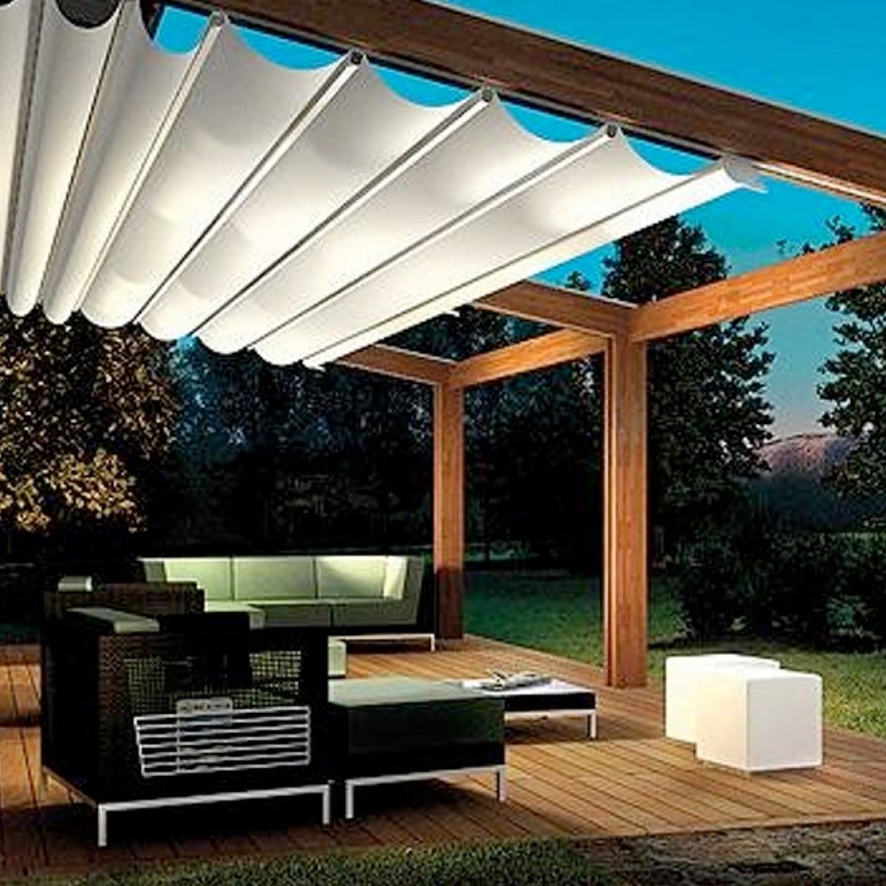
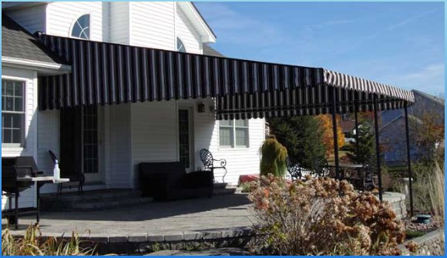
awning

Slide 10
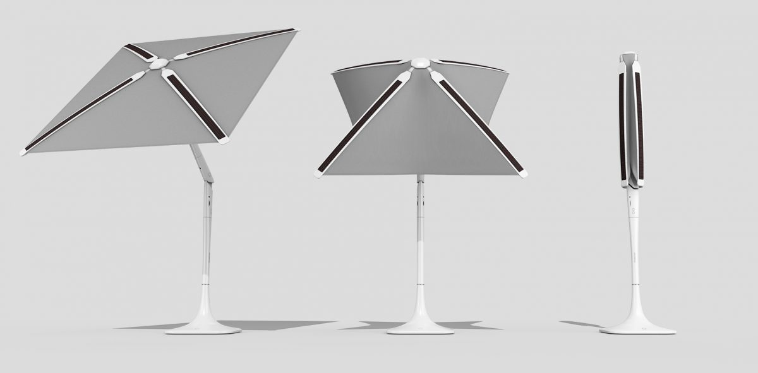
Shadecraft sunflower

Slide 11
Project management

Slide 12
quality
Costumer focus
Leadership
Engagement of people
Process aproach
Improvement
Evidence-based decision-making
Relationship management

Slide 13
Human resources
We used a RACI matrix to organize human resources.There are four types of designations in this matrix.
Responsible – Usually team members
Acountable – Usually team members
Informed – Used for supervisors, team members and teachers
Consulted – Used for supervisors and teachers

Slide 14
Risk
Quality management principles we are working with
Stages of risks
Specific risks we face
Our solutions for them

Slide 15
Procurement and Stakeholders management
Material comparison from multiple sources
Ensure our materials/components come from local/Portuguese suppliers
Focus on staying with budget
Previously identified stakeholders and roles they have

Slide 16
Marketing plan

Slide 17

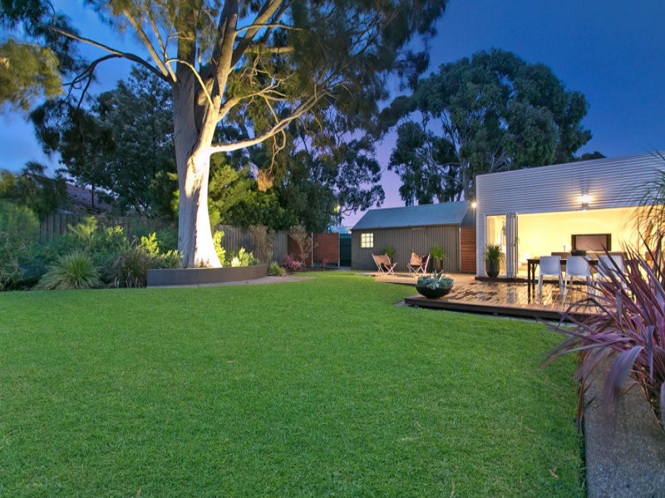
Target audience

Slide 18
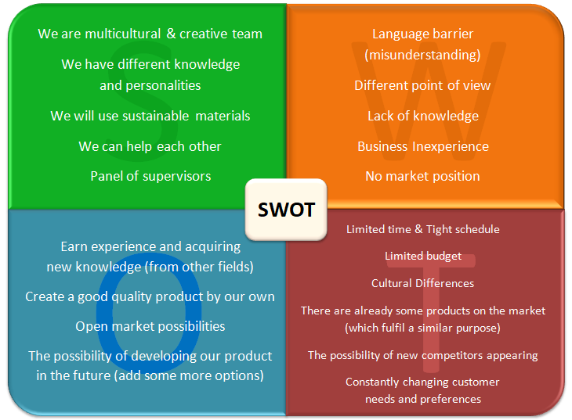

Slide 19
Eco-efficiency Measures for
Sustainability

Slide 20
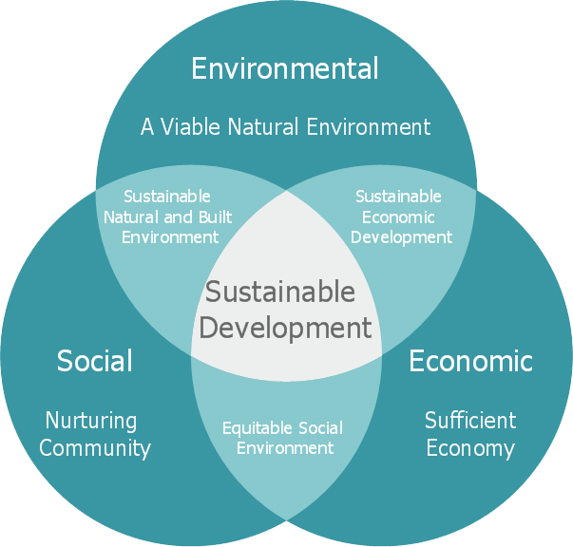

Slide 21
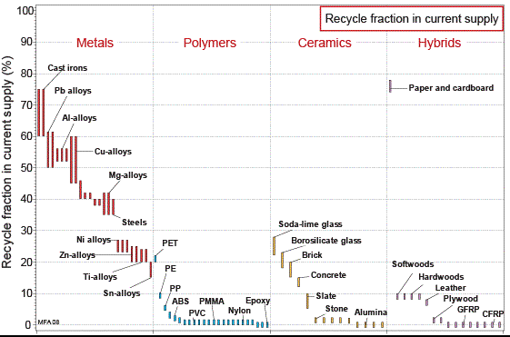
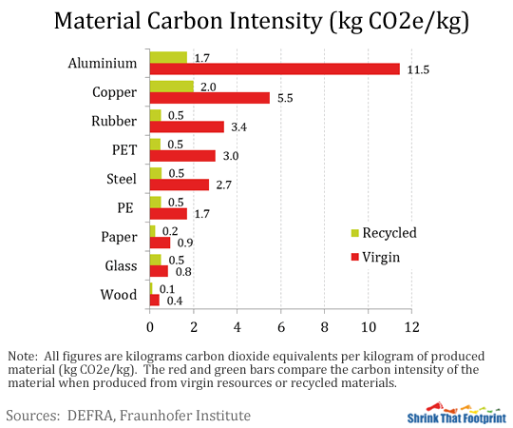
Environmental:
Low Carbon steel
Stainless steel
Copper
Economical:
Stimulation for economical groth
Equality
Period of economical growth
Social:
Work environment

Slide 22
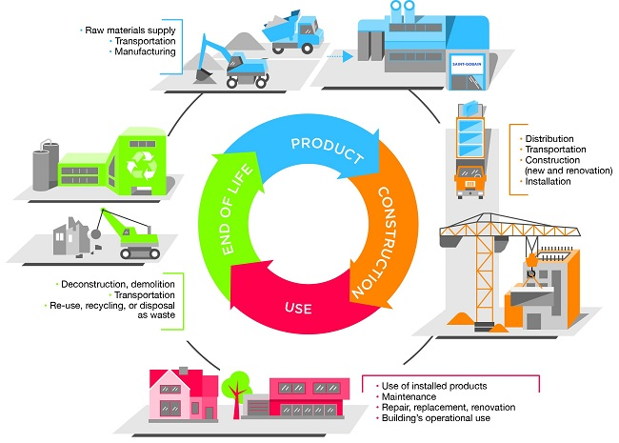
Life cycle analysis

Slide 23
Ethical and Deontological Concerns

Slide 24
Code of ethics
Honesty & saying his opinion
Respect is paramount
Every team member –
same rights
Decisions: discussed & decided together
Product doesn’t impair the consumer/ environment

Slide 25
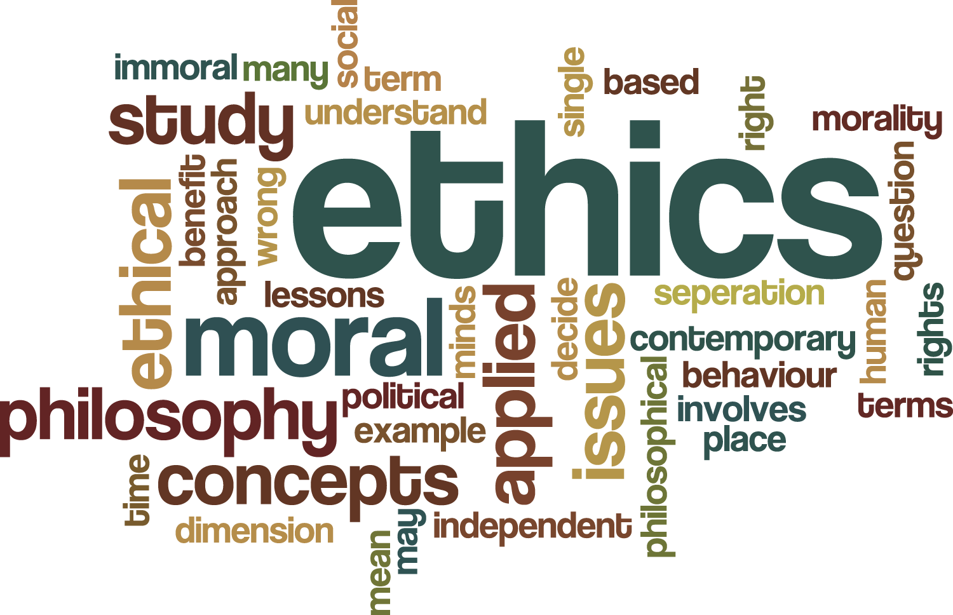
Engineering ethics
Strengths & weaknesses of every member
Other opinions, knowledge and experiences
Licensed software & open sourced projects

Slide 26
honest & transparent
No false claims or promises
Setsun- a good model for others
efficiency, renewability & a greener world

Slide 27
Liability
The product has to work properly
inside components are obtained from certified suppliers
Product manual
EU requirements regarding machinery & electronics

Slide 28
Product development

Slide 29
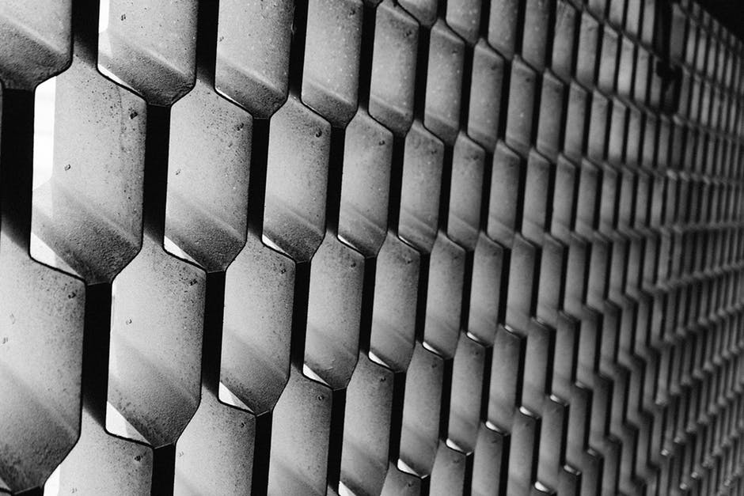
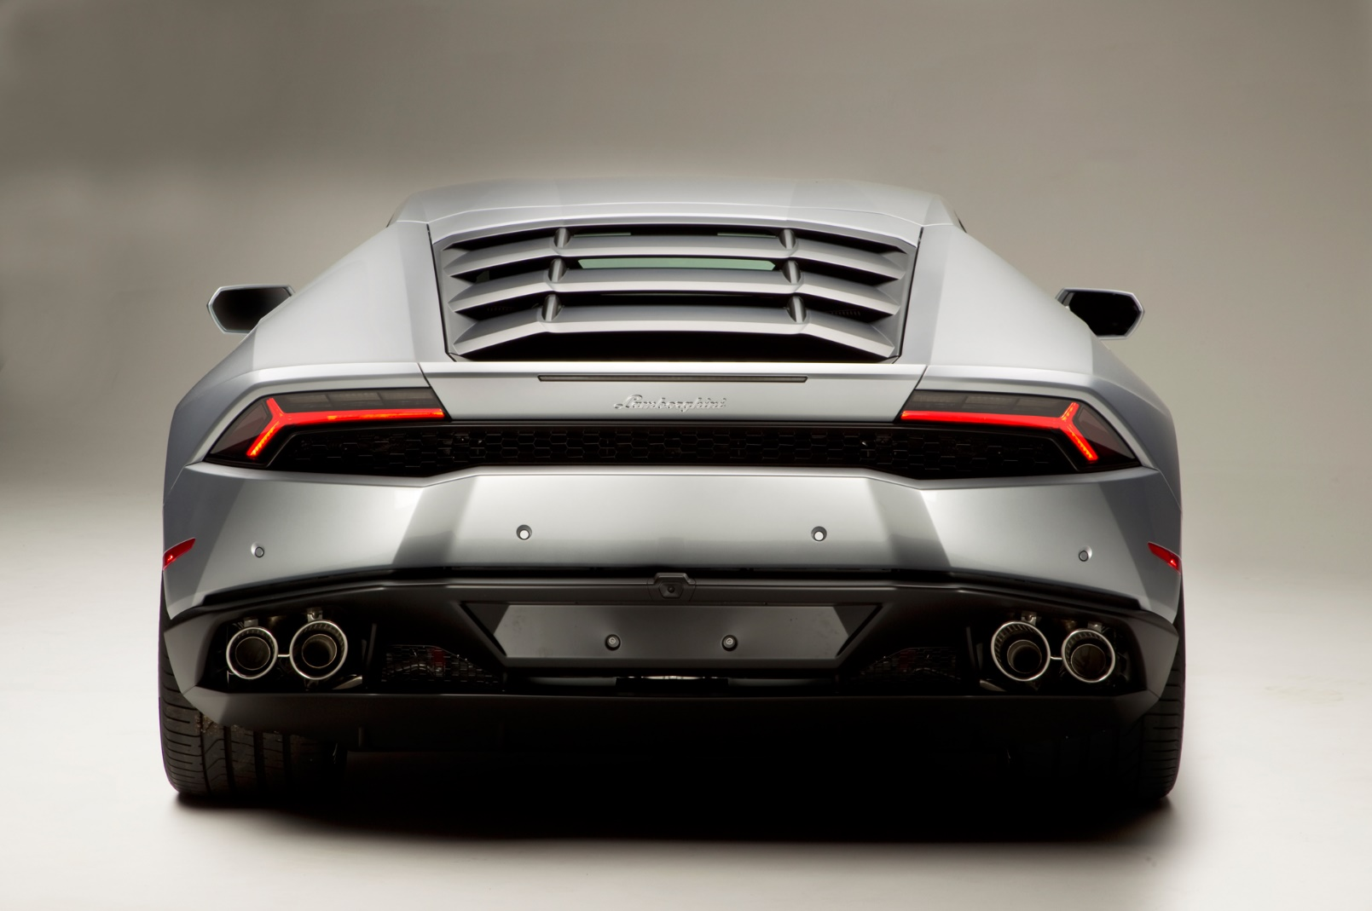
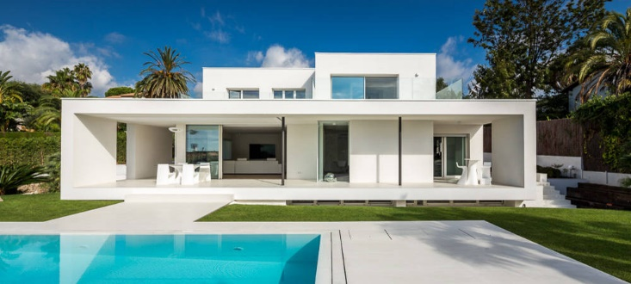
Architecture

Slide 30
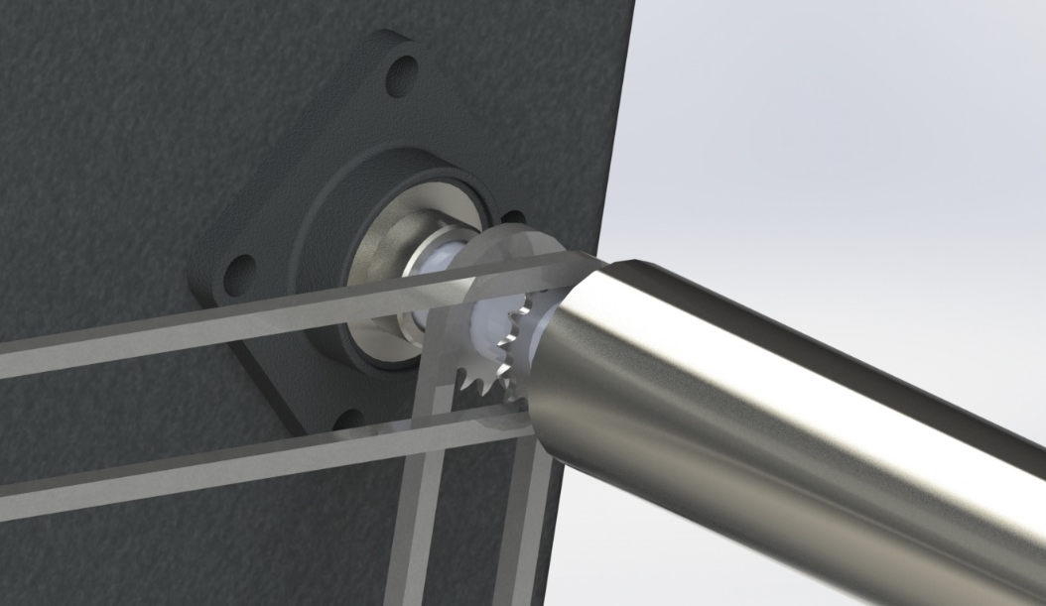
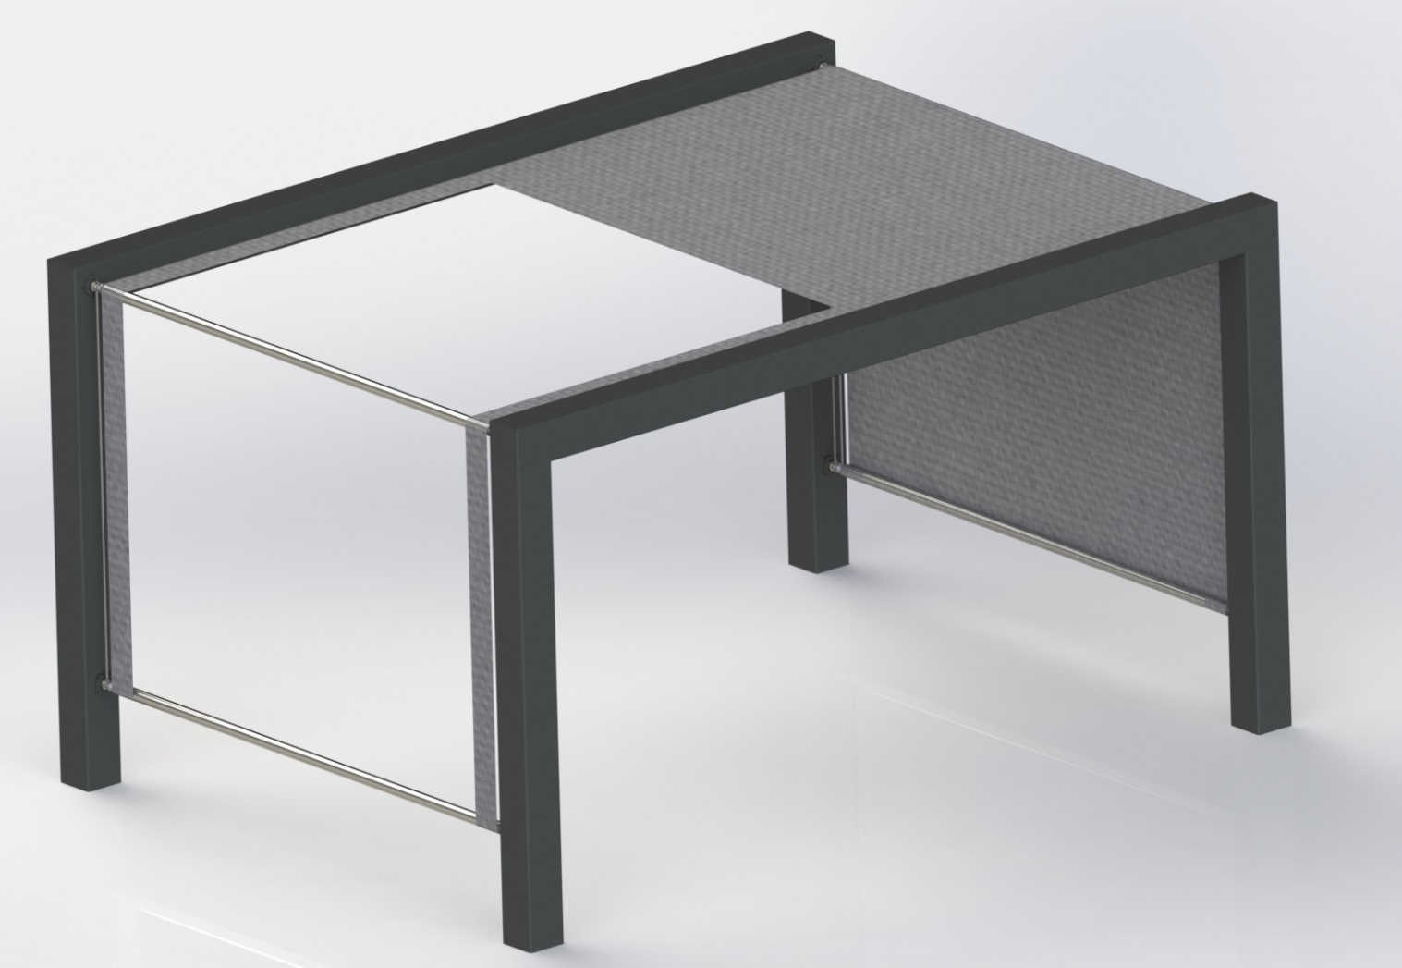
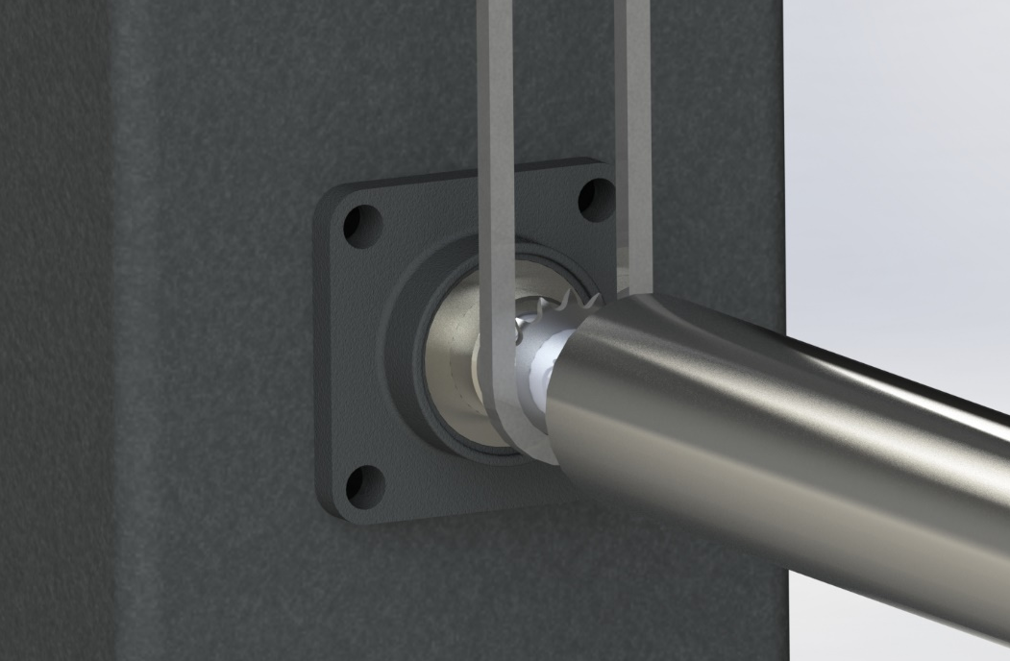
Final design

Slide 31
Electronics
Motor – 1
Arduino – Leonardo connected to motor through diode,resistor and transistor
Stand Alone Power Source (battery/power pack)

Slide 32
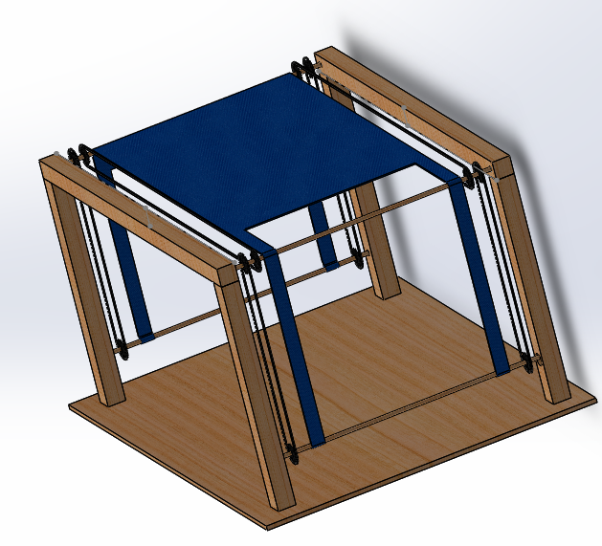
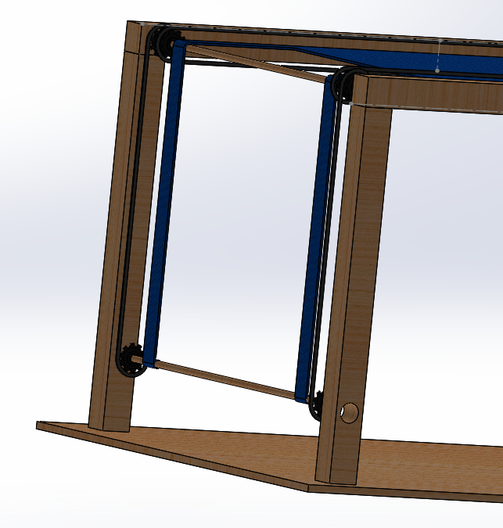
Prototype

Slide 33
Further development
Finish construction
Building prototype
Local providers list
Update report

Slide 34
Untill the next presentation!

