Slide 1



Outdoor Intelligent Shader

Slide 2
Agenda
Introduction
Our problem
State of the art
Idea
Project management
Marketing Plan
SWOT analysis
Eco-efficiency Measures for Sustainability
Life cycle analysis
Ethical and Deontological Concerns
Product development
Final Design
Next steps

Slide 3





We are TEAM 4!
Melanie
Media Technologies
Marta
Logistics
Sven
Industrial Product
Design
Christopher
Electric, Electronic
and Energy Engineering
Manuel Mechanical Engineering

Slide 4

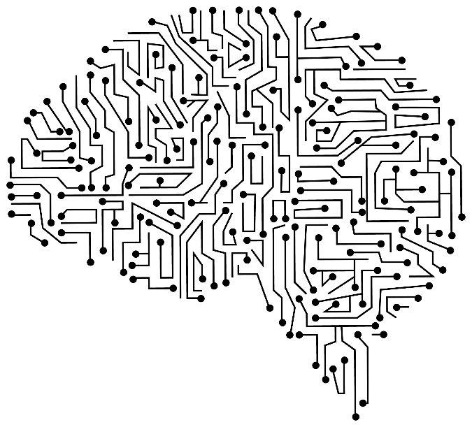
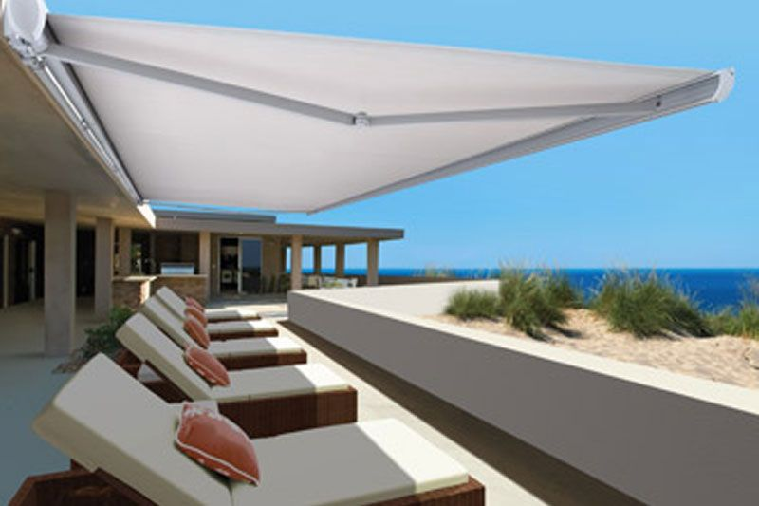
Our first thoughts
Outdoor Intelligent Shader

Slide 5

Problem
How can a shader be constructed so that
there is a constant shade on the terrace
while using smart electronics?

Slide 6
Requirements
Shader must always maintain the shade over the sitting area
All electronics must fit within the construction bow of the product
Shader must provide shade during the day based on a 180 degrees movement.

Slide 7

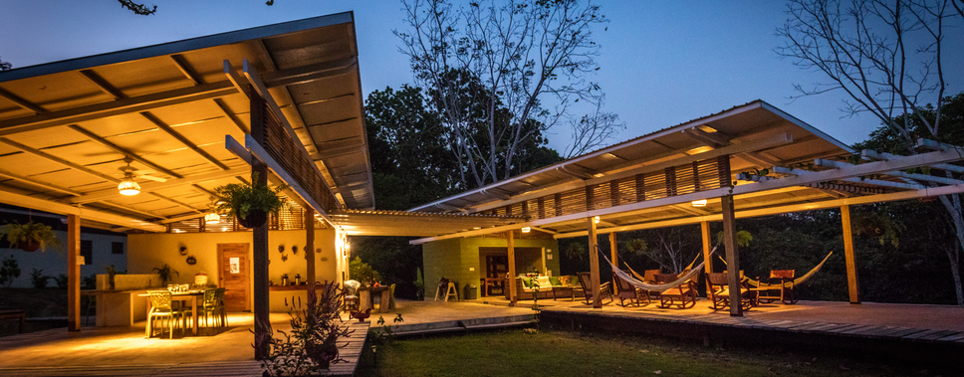
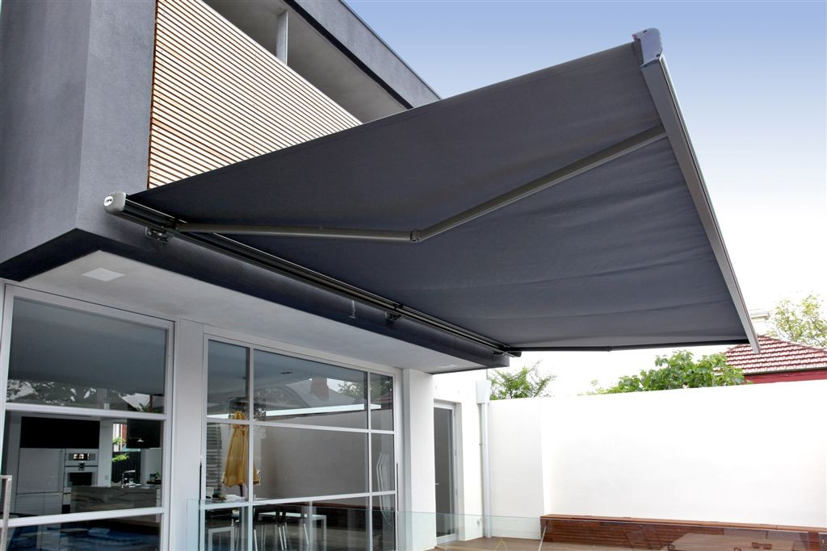
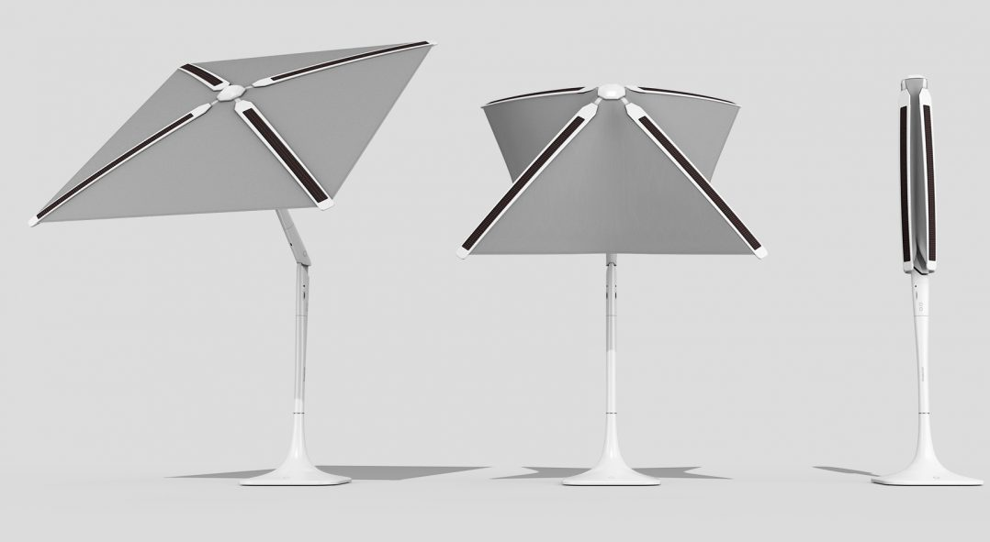
State of the Art
Parasol
Canopy
Awning
Shadecraft Sunflower

Slide 8
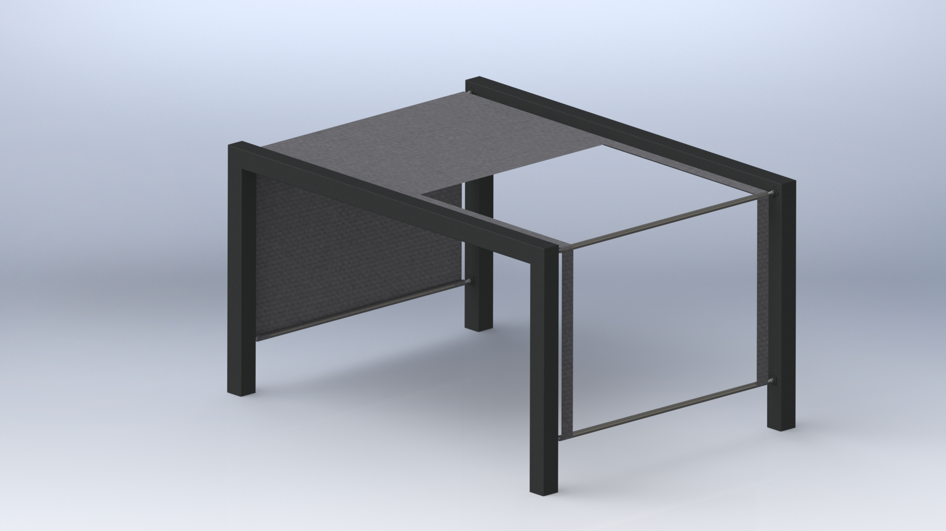
Our idea

Slide 9

Project Management - Quality
Leadership
Improvement
Evidence-based decision-making

Slide 10
Project Management – Risk
Quality management principles we are working with
Stages of risks
Specific risks we face
Our solutions for them

Slide 11
Procurement and Stakeholders management
Material comparison from multiple sources
Ensure our materials/components come
from local/Portuguese suppliers
Previously identified stakeholders and roles they have

Slide 12

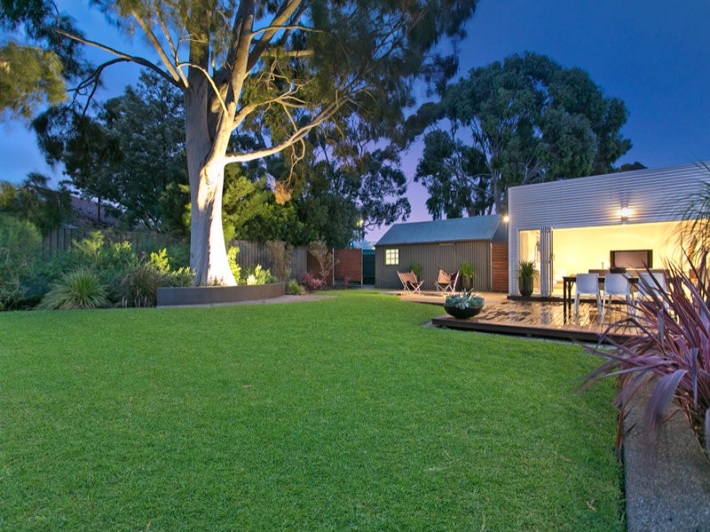
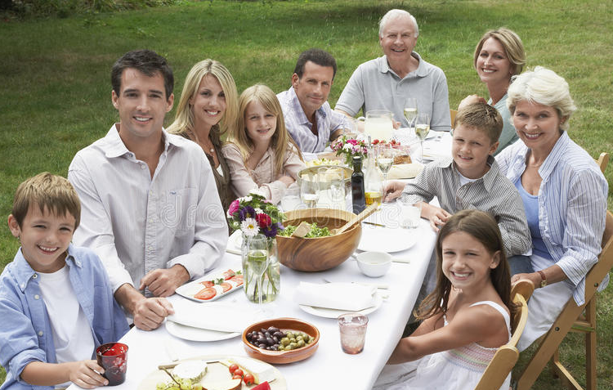
Marketing Plan - Target Audience

Slide 13
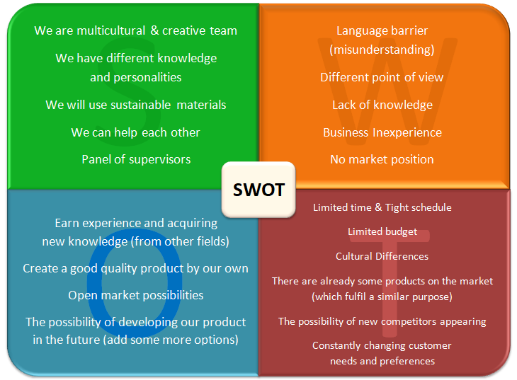
S
W
O
T
A
N
A
L
Y
S
I
S

Slide 14
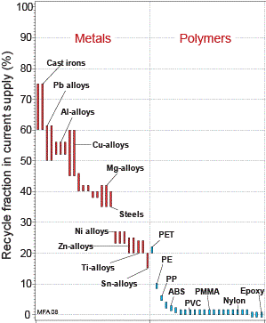
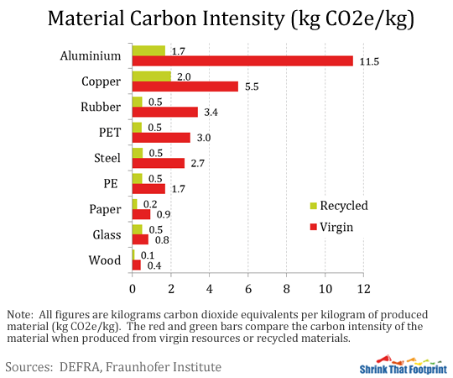
Eco-efficiency Measures for Sustainability
Environmental:
Low Carbon steel
Stainless steel
Copper
Social:
Work environment
Economical:
Stimulation for economical groth
Equality
Period of economical growth

Slide 15
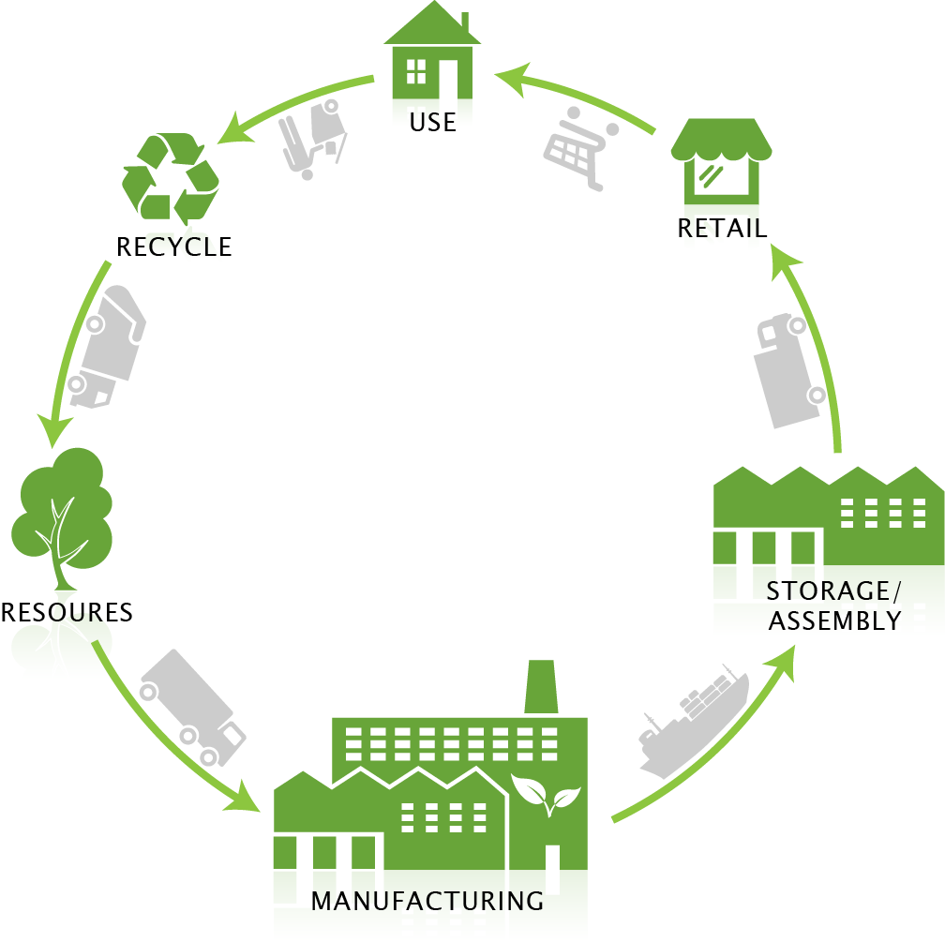
Life cycle analysis

Slide 16

Ethical and Deontological Concerns
Strengths & weaknesses of every member
Other opinions, knowledge and experiences
Licensed software & open sourced projects
Honest & transparent
Efficiency, renewability & a greener world

Slide 17
Liability
The product has to work properly
Inside components are obtained from certified suppliers
Product manual

Slide 18

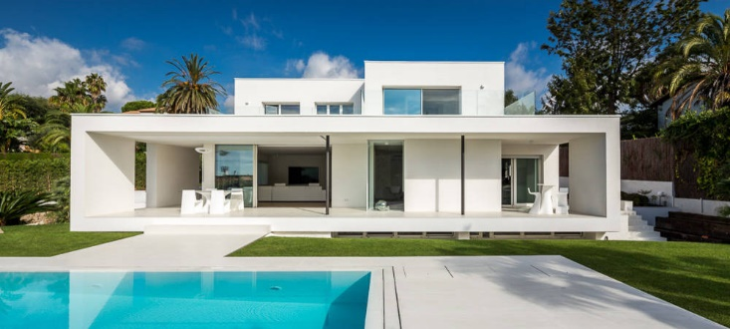
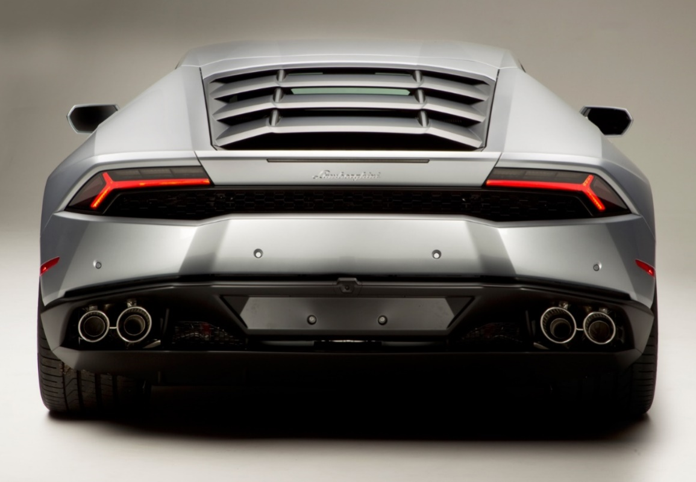
Product development - Inspiration

Slide 19
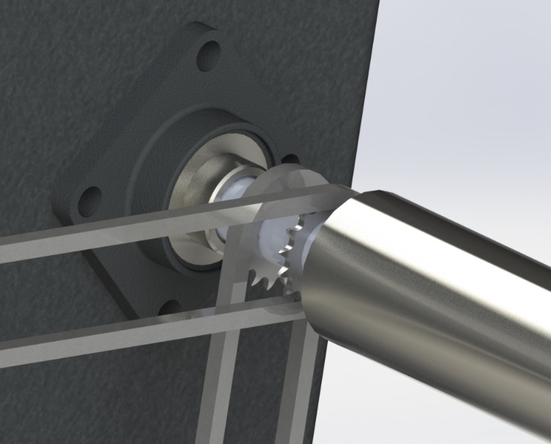
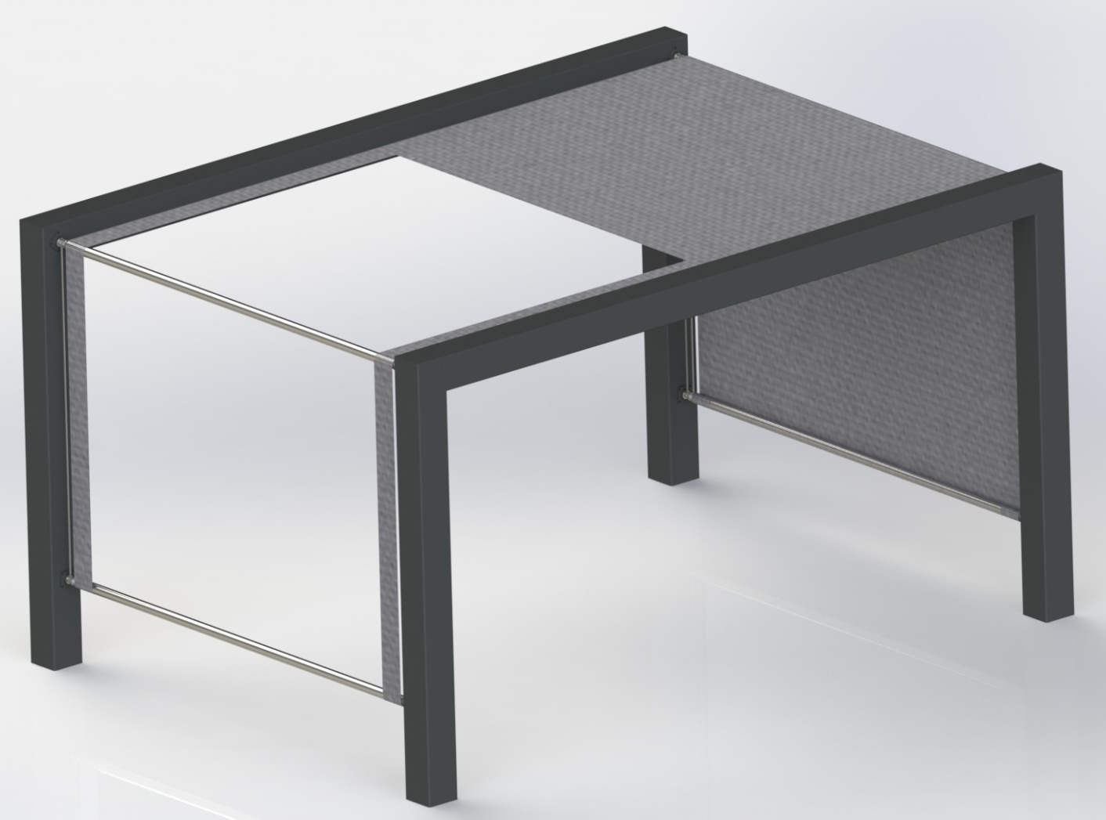
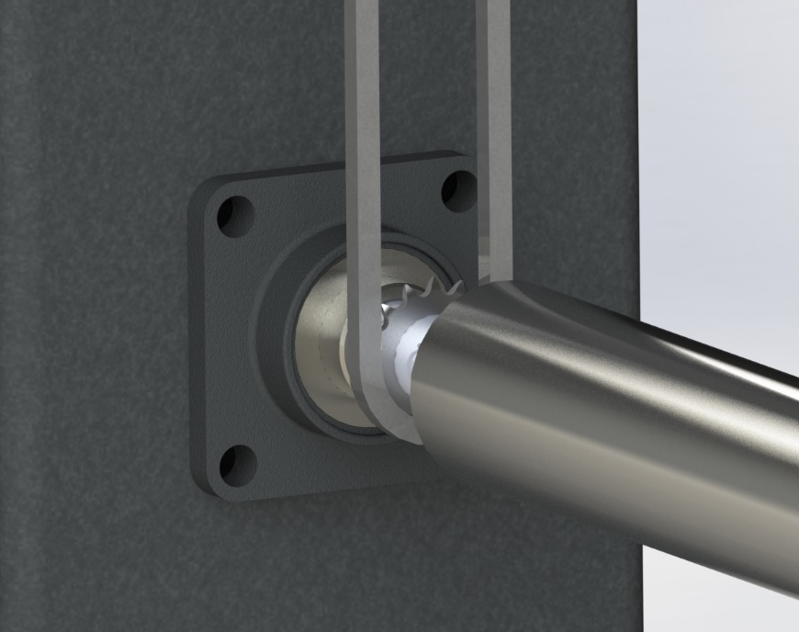
Final Design

Slide 20
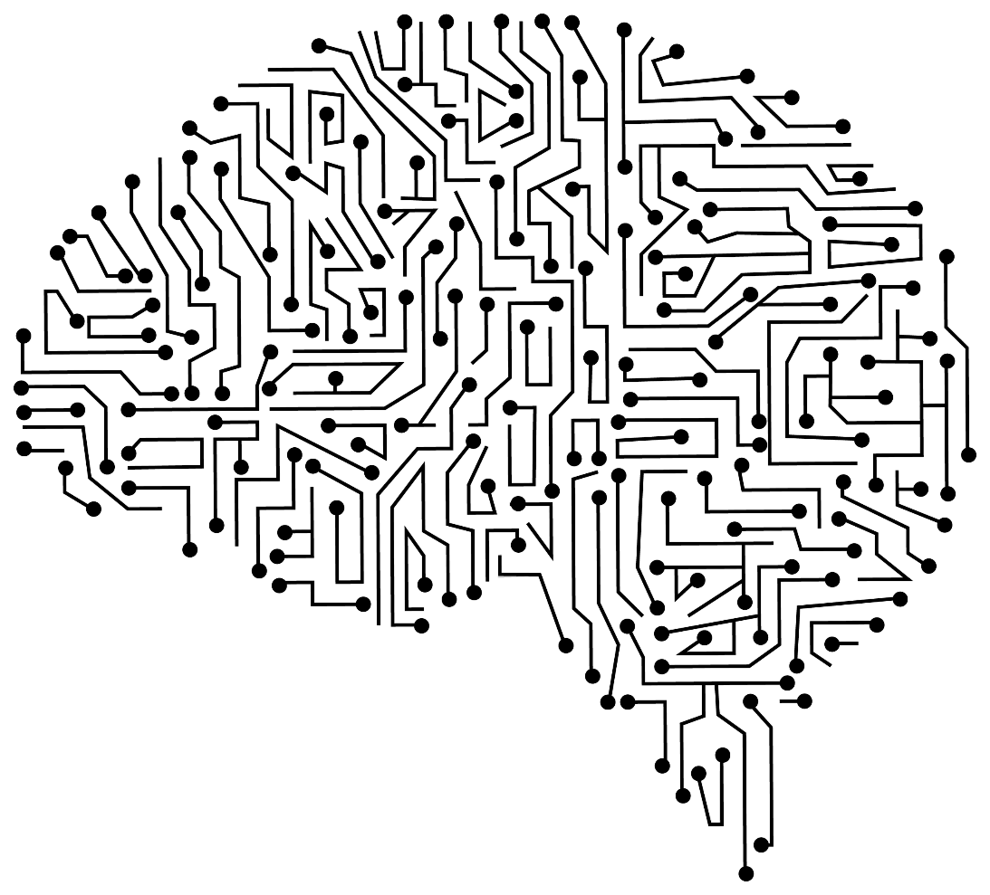
Electronics
Motor – 1
Arduino – Leonardo connected to motor through diode, resistor and transistor
Stand Alone Power Source (battery/power pack)

Slide 21
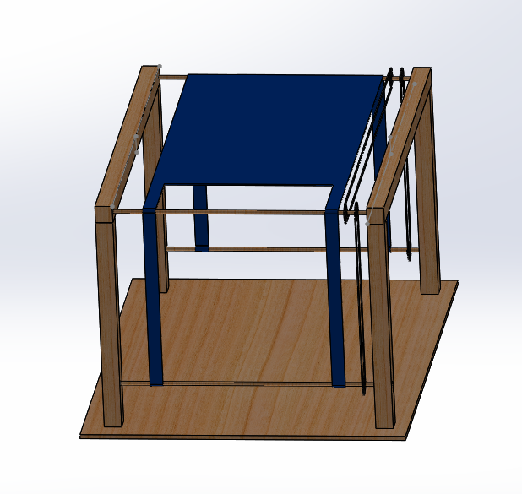
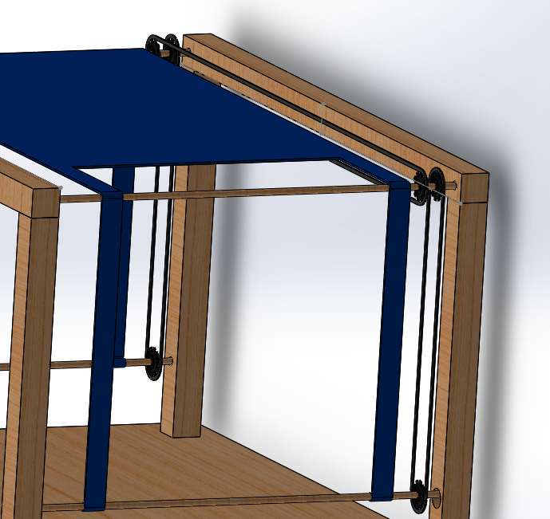
Prototype

Slide 22
Next steps ???
Finish construction
Local providers list
Building prototype
Update report

Slide 23
Thank you for your attention

