Slide 1
Setsun
User manual

Slide 2
Introduction
SetSun is a device designed to offer you and your family a safe and relaxing environment in which you will be able to enjoy being out in the sun in the summer months whilst also being able to speak and socialise with friends and family over a meal, a few drinks or even just a sparkling conversation. You can enjoy all of these scenarios and more after your SetSun is installed and working. SetSun offers one of the best ways to enjoy fresh air in your own back garden and greatly reduces the risk of sunburn or sunstroke by providing you with constant shade whilst you and your companions sit underneath it.

Slide 3
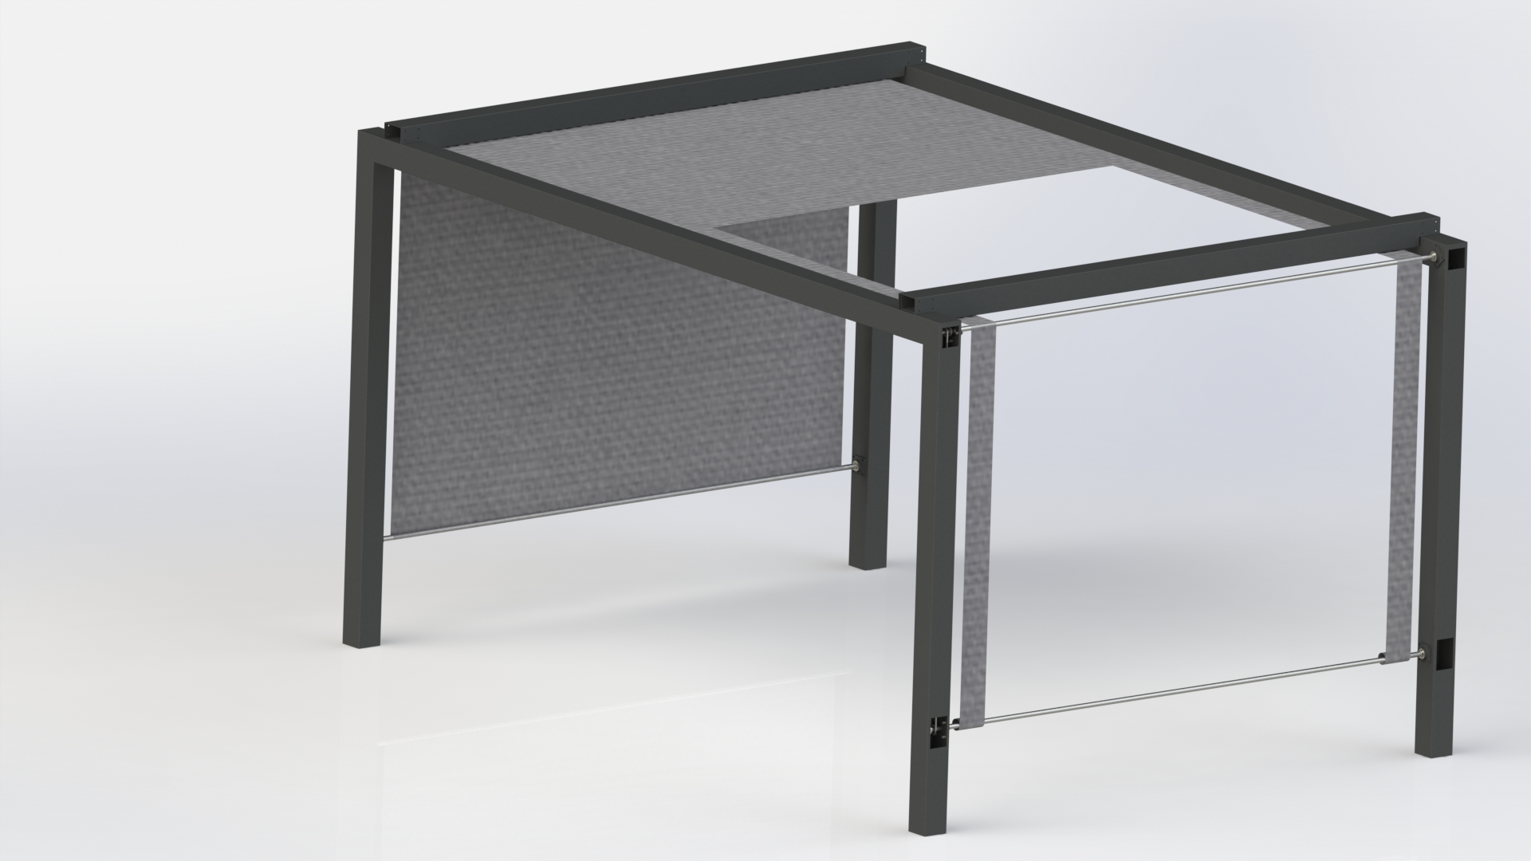
Outline of the device
As can be seen the moving parts of SetSun are exposed and therefore it is advised to keep away from any water or naked flames the could result in the motor being damaged or the belts being broken.
It simplistic structure means it does not take long to assemble when you have all of the moving parts but do bear in mind that when moving the product is it best to have it taken apart and rebuilt for health and safety concerns.

Slide 4
Useful Information
When installed in place it is ideal that SetSun will not need to be moved again unless the customer is moving house, so please keep this in mind when deciding exactly where to have your SetSun installed.
After it has been installed the SetSun device needs only to be plugged in and the preprogramed algorithm, that was uploaded into the device at the time of manufacture, will begin to control the positioning of the shader cloth throughout the day to ensure any and all inhabitants under the structure are sufficiently protected from the sunlight.

Slide 5
Maintaining a safe system
When using the SetSun device it is advised that the customer keeps it away from any damp or muddy environments, this is advised due to the exposed gears and mechanisms that allow the shader cloth to move over the structure. Any damp or mud that gets into the moving parts of this product will cause problems such as rust in the metals and will have an adverse effect on the belts in the system. It is advised that you keep your hands and any loose clothing away from the moving parts to avoid injury or damaging the customer.
Avoid lighting any kind of fire underneath this structure as is it could lead to discolouration of the cloth and damage to the systems mechanisms not to mention this could also create a huge fire risk so please do not have any fires or open flames under structure

Slide 6
Problems / Solutions
Motor burns out or stops working – This will be covered as part of your warranty. Do not attempt to fix by yourself, simply call our company for a technician to come out and fix the problem.
Belt becomes stretched, loose or damaged – This is also covered as part of your warranty. Do not attempt to fix by yourself, simply call our company for a technician to come out and fix the problem.
Proximity sensors are no longer registering the cloth – This is also covered as part of your warranty. Do not attempt to fix by yourself, simply call our company for a technician to come out and fix the problem.
Any damage to the outer structure i.e. cracks, dents, or rust is not covered as part of your warranty unless it can be proven that the product was faulty before the point of delivery and installation.

Slide 7
Safety regulations
SAFETY
As this system is used to cover a family it is quite large in stature and because of this, it is advised to take great care when standing or moving near the supporting parts of the structure.
Do not try to tamper or alter the electronics in anyway as this is connected to the mains supply and could result in serious injury
RECYCLING
As our prototype is made primarily out of painted wood it is not entirely recyclable

